Slide 1
“Smart City: Future Perspectives”
Presenter: Rustam Karimjonov
Head of Strategic Planning for ICT Development
and IT Convergence Department
Ministry for Development of Information Technologies
and Communications of the Republic of Uzbekistan

Slide 2
A city isn’t smart because it uses technology,
a city is smart because it uses technology
to make its citizens’ lives better.

Slide 3
Development of IoT for Smart Cities
2000
2005
2010
2015
2020
2030
In 2000 - No term such as IoT
In 2015 - 6 billion of IoT devices worldwide
In 2030 - over 100 billion of IoT devices over the world
Convergence of smart houses, sensor systems parking, house management, housing and public utilities all together will form a Smart Cities.

Slide 4

Why we focus today on smart cities?
Today 3.6 billion people live in cities
By 2050, 75% of the world’s population will live in cities
Up to 80 billion connected objects by 2020
Eventually everything and everyone
will be interconnected with each other.

Slide 5
Internet of Things
Smart Education
Smart Health
Smart Mobility
Smart Government
Smart Agriculture
Smart Environment
Open Data
Safety and Secure
Smart Business
Smart Utility
Smart Buildings
Smart cities have the potential to improve the quality of life, while ensuring the needs of present and future generations with respect to economic, social and environmental challenges.

Slide 6
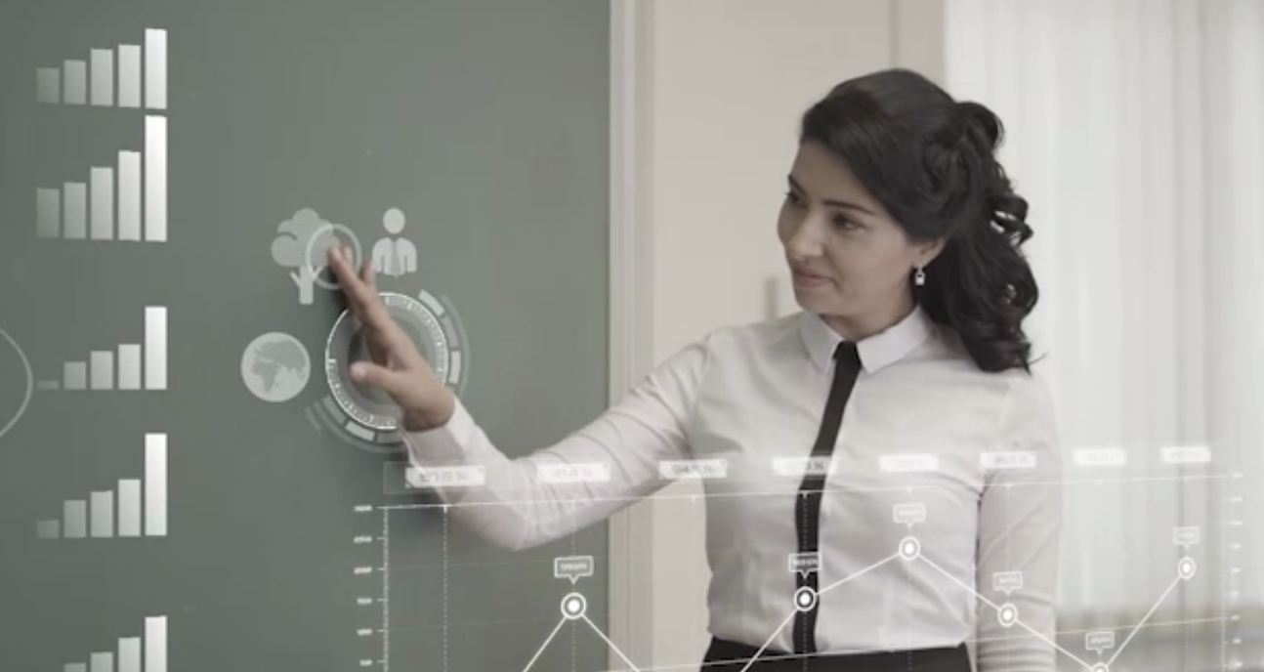
Short term “Smart city” projects development in Uzbekistan
Energy-efficient and Low-carbon Houses in Rural Areas
Reduce energy consumption and greenhouse gas emissions.
The project is funded by the Global Environment Facility (GEF) and UNDP. Eligible costs is $ 6.3 million
Passenger transport monitoring system
Tracking the bus traffic on the chosen route, time of their arrival at the required stop and such parameters as the state number, speed and distance from bus stop.
Smart Utility Service
Install special electronic meters for hot and cold water, gas, electricity, heating and implement the integrated platform to manage process of providing and using utility services.
Traffic Control System
Reduce traffic violation and ensure safety of road users.

Slide 7
“Smart city” development roadmap
Live smarter life
Implement
Smart city
projects
Build a strategy
Infrastructure
From small to big
Connect people

Slide 8
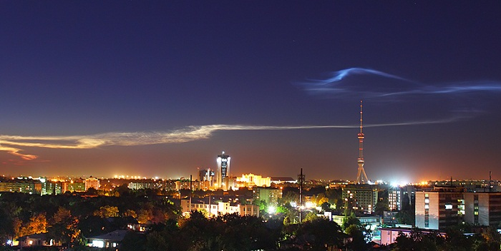
Wise management of resources results in
High Quality of Life

